Slide 1





Gentle refining of omega-3 oils
Notes:
……..

Slide 2


The variety of oils and fats we produce, combined with our expertise, makes our offering unique to customers:
Refining pure and high-quality end products
Tailor-made production solutions
Oils and Fats – Refined in a sophisticated way
Collaboration with our customers to identify trends
Small batch production
National and international operations
Swiss leader in special and organic products
Swiss Made Quality
Our Premium Fat Product Range
Notes:
……..

Slide 3

With our advanced technologies, we offer a range of benefits:
Pure products:
We eliminate impurities while preserving micronutrients at low temperatures
Optimal fatty acid distribution:
The process technology ensures an ideal distribution of fatty acids, perfect for infant formulas
Avoid process contaminants:
The gentle refining process minimises risks and ensures the highest product quality
We offer solutions
Notes:
……..

Slide 4
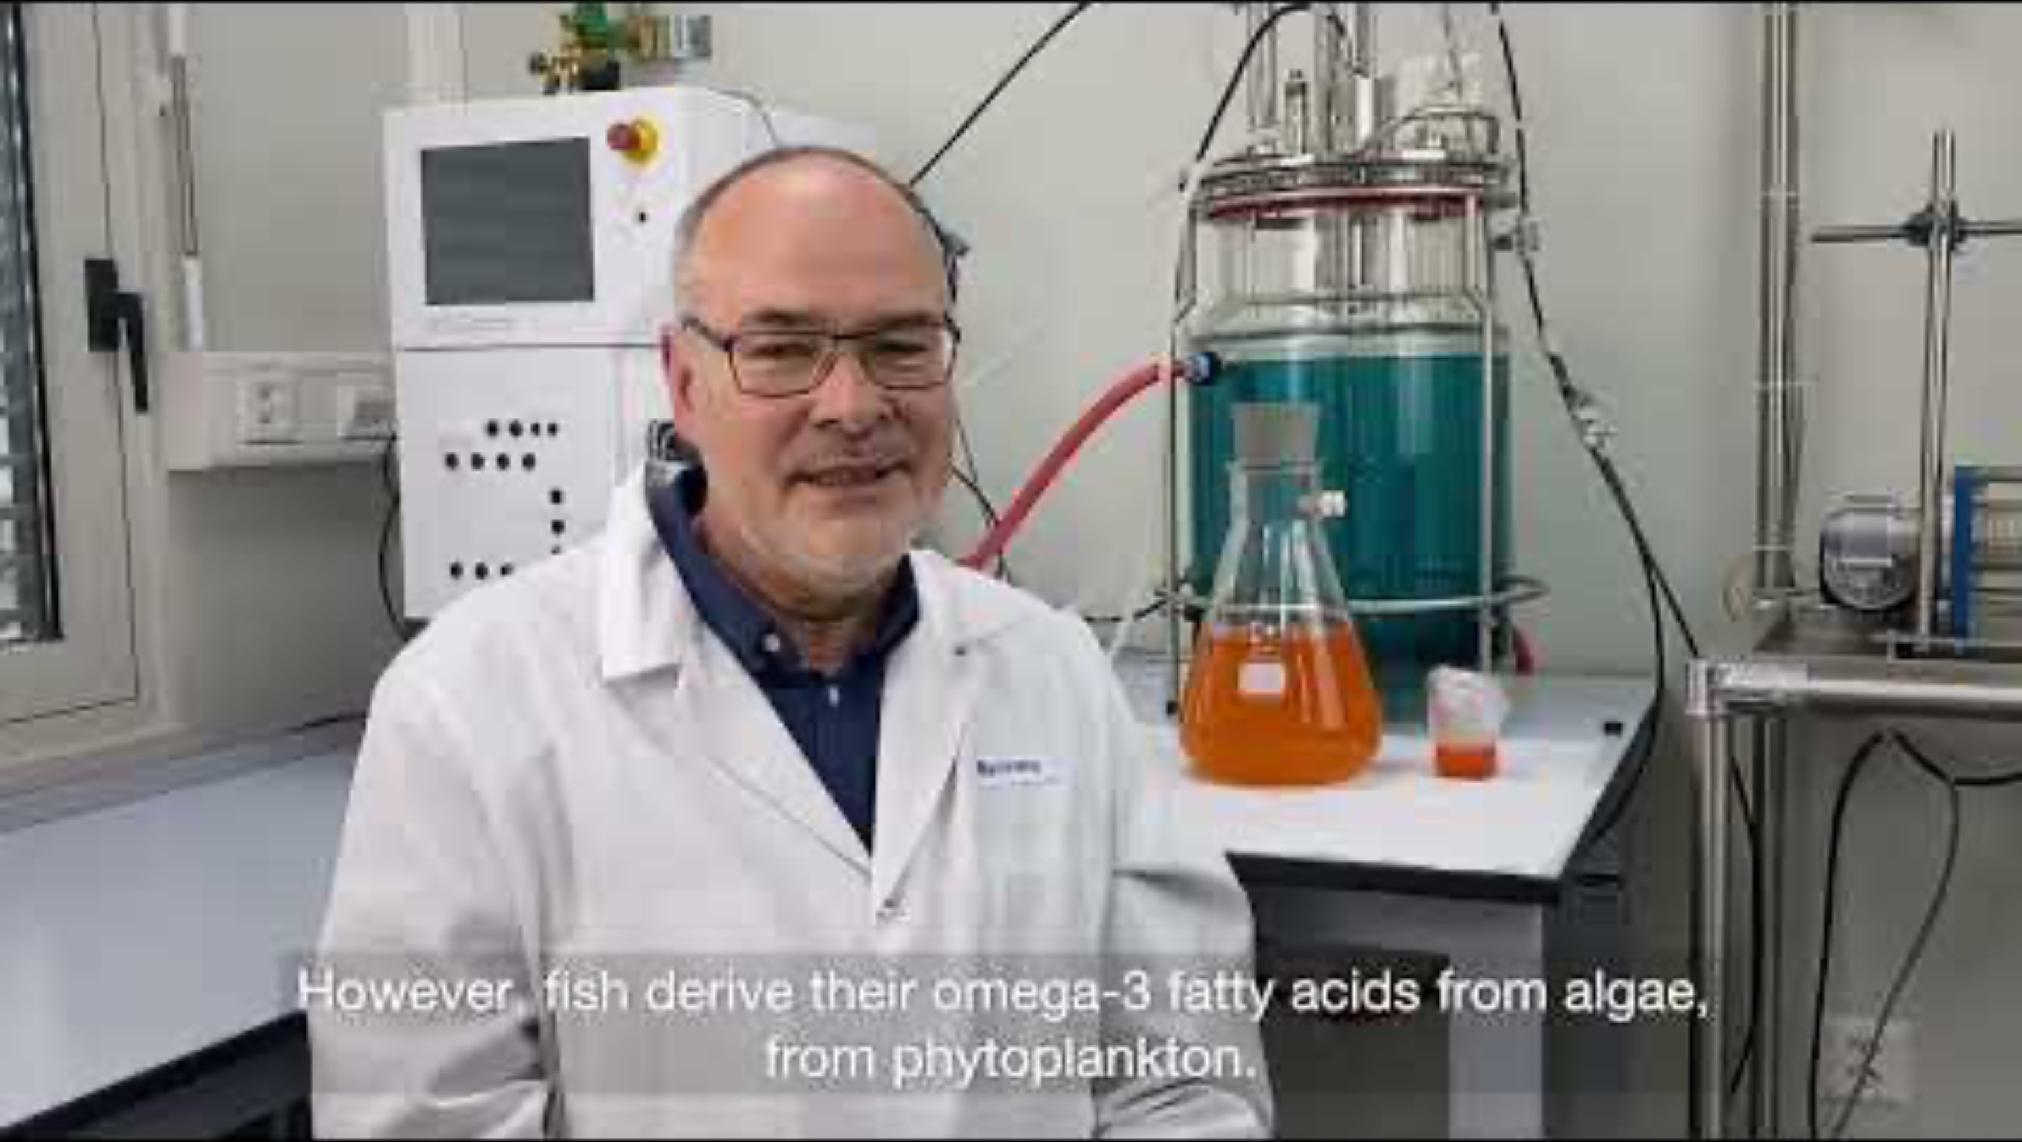
Gentle refining of omega-3 oils:
High-quality products: Support in the delivery of omega-3 products
Nutrient-dense oils: Nutritional and physiological benefits found in rapeseed, flaxseed, fish and microalgae oils
Gentle processes: Development of processes for the gentle refining of sensitive omega-3 oils
We offer solutions
Notes:
……..

Slide 5

Any questions? Contact our expert!
Frank Möllering
Head of Research & Development
+41 32 387 48 30
frank.moellering@nutriswiss.ch
For more information, visit our website:
NUTRISWISS - Gentle refining of omega-3 oils
We look forward to welcoming you
Notes:
……..

